Slide 1

Presentation on DJANGO
Prepared By : Mayank Jain

Slide 2
Content
Introduction
Characteristics of Django
Features of Django
Companies Using Django
Django Architecture
Setup & Installation
CRUD Operation

Slide 3
Introduction
Django is a high-level Python web framework that encourages rapid development and clean, pragmatic design.
Django makes it easier to build better web apps quickly and with less code.
Released publicly under a BSD license in July 2005. The framework was named after guitarist Django Reinhardt.
Flexible template language.
Includes ORM that supports many databases.
Lots of extras included – csrf protections, sessions, caching, authentication.
Notes:
2003 − Started by Adrian Holovaty and Simon Willison as an internal project at the Lawrence Journal-World newspaper.
Flexible template language that can be used to generate HTML, CSV, Email or any other format.
Includes ORM that supports many databases – Postgresql, MySQL, Oracle, SQLite.
Lots of extras included – middleware, csrf protections, sessions, caching, authentication.

Slide 4
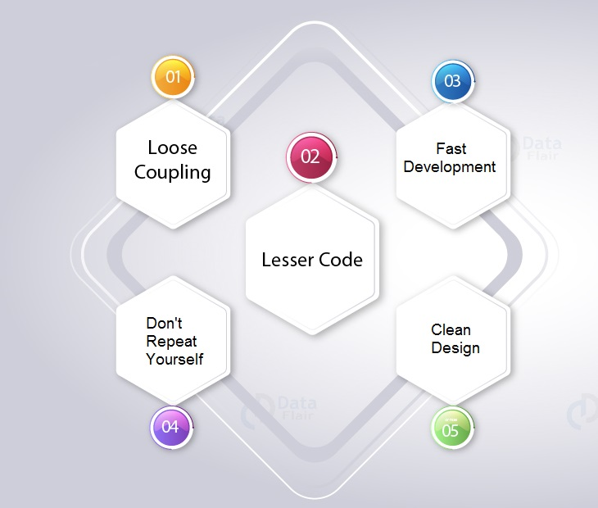
Characteristic of Django
Notes:
Loosely Coupled − Django helps you to make each element of its stack independent of the others.
Less code so in turn a quick development.
Provide Rich Library support so that it encourges fast development
Don't Repeat Yourself (DRY) − Everything should be developed only in exactly one place instead of repeating it again and again.
Django strictly maintains a clean design throughout its own code and makes it easy to follow best web-development practices.

Slide 5
Features Of Django
Object-Relational Mapping (ORM) Support
Multilingual Support.
Simple but powerful URL system
Built-in authentication system
Automatic admin interface feature allows the functionality of adding, editing and deleting items
Cache framework comes with multiple cache mechanisms.
Notes:
Automatic admin interface feature allows the functionality of adding, editing and deleting items. You can customize the admin panel as per your need.

Slide 6

Companies Using Django

Slide 7
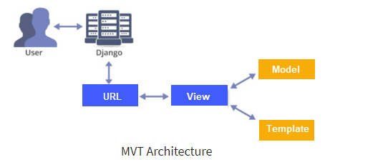
Django Architecture
Notes:
The Model-View-Template (MVT) is a different concept compared to MVC.
The main difference between these two architectural patterns is that Django itself manages the Controller part (software code that controls the interactions between the Model and View).
The template is an HTML file which mixed with Django Template Language file which also called DTL.
As seen in above diagram, a user requests for a resource to Django. Django acts as a controller and checks to the available resource in URL.
If URL maps, a view is called which interacts with model and template.
Django then responds to the user and sends a template as a response.

Slide 8
Setup & Installation
Create virtual Enviornment.
install django under this env.
install django.
Create A Django Application
Notes:
Once we write lambda expression we can call that expression just like a method, for this functional interfaces are required.

Slide 9
Commands
python3 -m venv <name_of_enviornment>
source <name_of_enviornment>/bin/activate
pip3 install Django
django-admin startproject <name_of_project>
cd <name_of_project>
django-admin startapp <name_of_app>
python3 manage.py runserver
Notes:
If an interface contain only one abstract method, such type of interfaces are called functional interfaces and the method is called functional method or single abstract method (SAM).
Inside functional interface in addition to single Abstract method (SAM) we write any number of default and static methods.

Slide 10

Project Setup
Create your first project.
django-admin startapp <name_of_project>
django-admin startapp myproject
Notes:
In Java 8, Sun Micro System introduced @Functional Interface annotation to specify that the interface is Functional Interface.
Inside Functional Interface we can take only one abstract method, if we take more than one abstract method then compiler raise an error message that is called we will get compilation error.

Slide 11
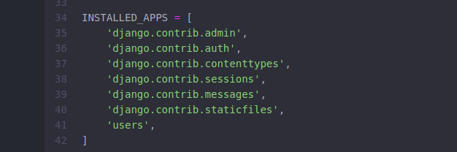
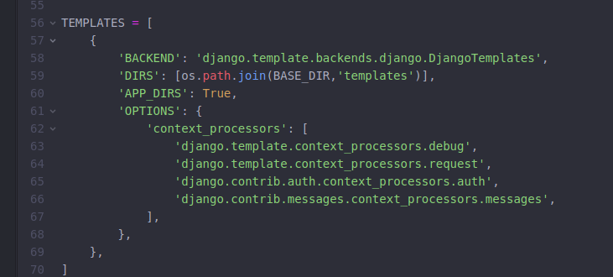
Setting.py
Notes:
In Java 8, Sun Micro System introduced @Functional Interface annotation to specify that the interface is Functional Interface.
Inside Functional Interface we can take only one abstract method, if we take more than one abstract method then compiler raise an error message that is called we will get compilation error.

Slide 12
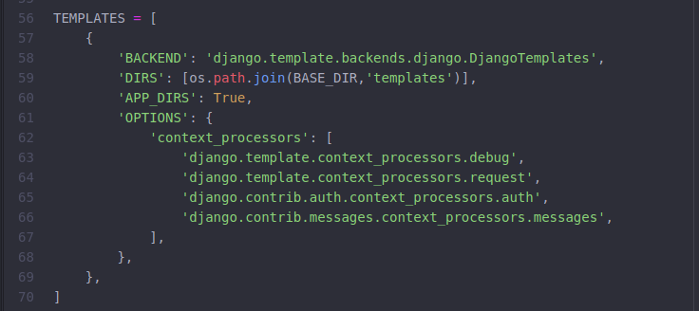
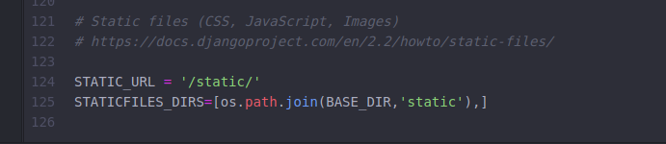
Setting.py
Notes:
In Java 8, Sun Micro System introduced @Functional Interface annotation to specify that the interface is Functional Interface.
Inside Functional Interface we can take only one abstract method, if we take more than one abstract method then compiler raise an error message that is called we will get compilation error.

Slide 13
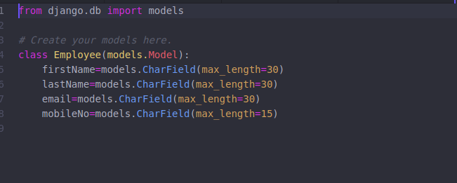
models.py
Notes:
In Java 8, Sun Micro System introduced @Functional Interface annotation to specify that the interface is Functional Interface.
Inside Functional Interface we can take only one abstract method, if we take more than one abstract method then compiler raise an error message that is called we will get compilation error.

Slide 14
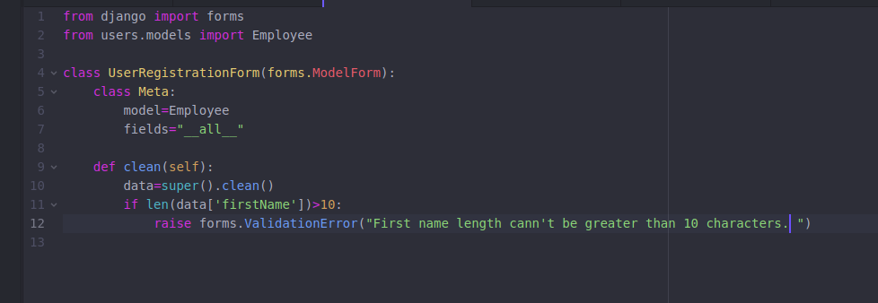
forms.py
Notes:
In Java 8, Sun Micro System introduced @Functional Interface annotation to specify that the interface is Functional Interface.
Inside Functional Interface we can take only one abstract method, if we take more than one abstract method then compiler raise an error message that is called we will get compilation error.

Slide 15
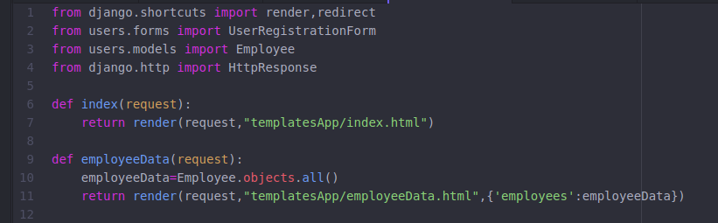
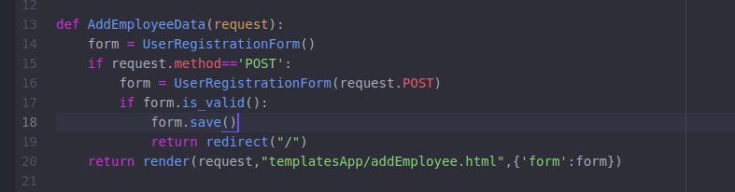
views.py
Notes:
In Java 8, Sun Micro System introduced @Functional Interface annotation to specify that the interface is Functional Interface.
Inside Functional Interface we can take only one abstract method, if we take more than one abstract method then compiler raise an error message that is called we will get compilation error.

Slide 16
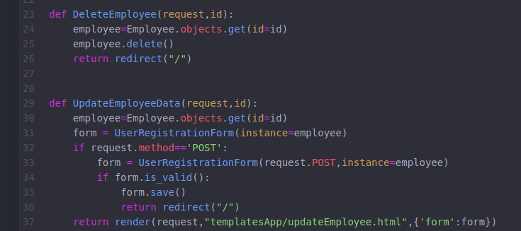
views.py
Notes:
In Java 8, Sun Micro System introduced @Functional Interface annotation to specify that the interface is Functional Interface.
Inside Functional Interface we can take only one abstract method, if we take more than one abstract method then compiler raise an error message that is called we will get compilation error.

Slide 17
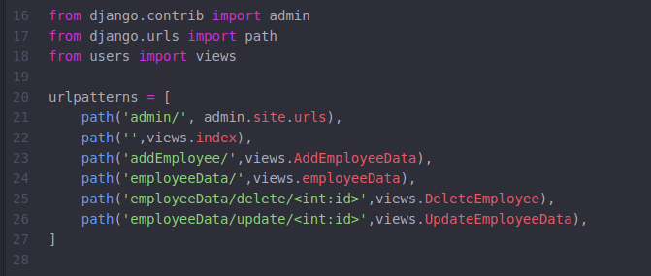
urls.py
Notes:
In Java 8, Sun Micro System introduced @Functional Interface annotation to specify that the interface is Functional Interface.
Inside Functional Interface we can take only one abstract method, if we take more than one abstract method then compiler raise an error message that is called we will get compilation error.

Slide 18
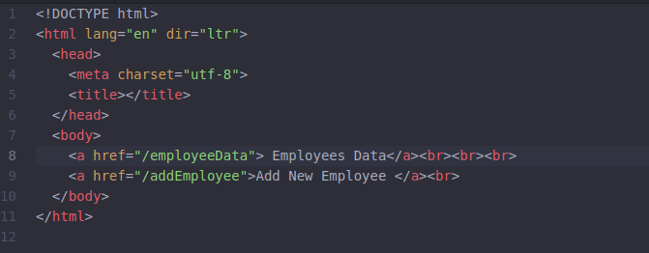
Templates
index.html
Notes:
In Java 8, Sun Micro System introduced @Functional Interface annotation to specify that the interface is Functional Interface.
Inside Functional Interface we can take only one abstract method, if we take more than one abstract method then compiler raise an error message that is called we will get compilation error.

Slide 19
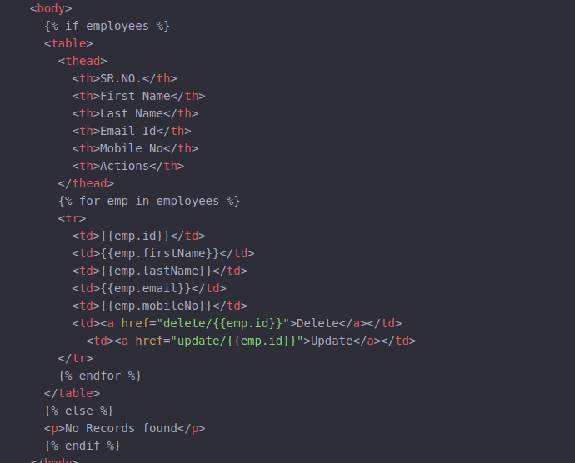
Templates
employeeData.html
Notes:
In Java 8, Sun Micro System introduced @Functional Interface annotation to specify that the interface is Functional Interface.
Inside Functional Interface we can take only one abstract method, if we take more than one abstract method then compiler raise an error message that is called we will get compilation error.

Slide 20
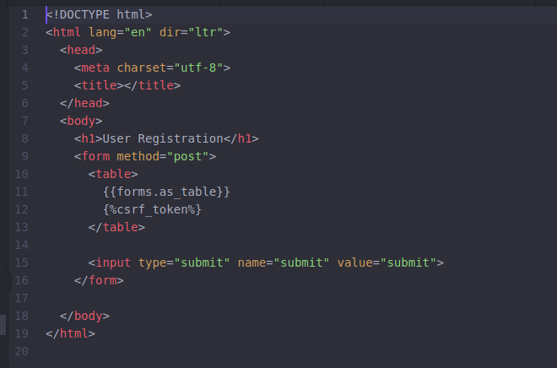
Templates
userRegistration.html
Notes:
In Java 8, Sun Micro System introduced @Functional Interface annotation to specify that the interface is Functional Interface.
Inside Functional Interface we can take only one abstract method, if we take more than one abstract method then compiler raise an error message that is called we will get compilation error.

Slide 21
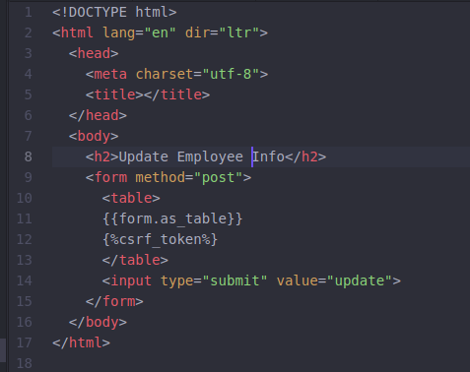
Templates
updateEmployee.html
Notes:
In Java 8, Sun Micro System introduced @Functional Interface annotation to specify that the interface is Functional Interface.
Inside Functional Interface we can take only one abstract method, if we take more than one abstract method then compiler raise an error message that is called we will get compilation error.

Slide 22
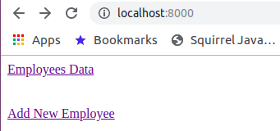
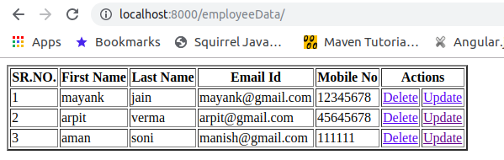
Output
Home page
Employee Data
Notes:
In Java 8, Sun Micro System introduced @Functional Interface annotation to specify that the interface is Functional Interface.
Inside Functional Interface we can take only one abstract method, if we take more than one abstract method then compiler raise an error message that is called we will get compilation error.

Slide 23
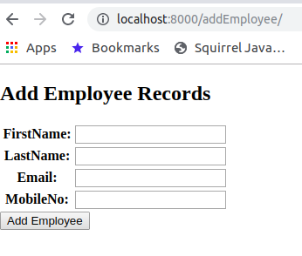
Output
Add New Employee
Notes:
In Java 8, Sun Micro System introduced @Functional Interface annotation to specify that the interface is Functional Interface.
Inside Functional Interface we can take only one abstract method, if we take more than one abstract method then compiler raise an error message that is called we will get compilation error.

Slide 24
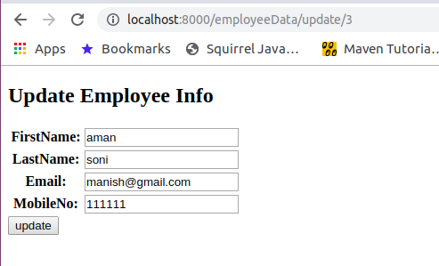
Output
Update
Notes:
In Java 8, Sun Micro System introduced @Functional Interface annotation to specify that the interface is Functional Interface.
Inside Functional Interface we can take only one abstract method, if we take more than one abstract method then compiler raise an error message that is called we will get compilation error.

Slide 25


